Slide 1
Climate Ready Hawaiʻi: Coordinator’s Update
July 20, 2022 Meeting

Slide 2
Current Projects
ADAPTATION WORK
Punaluʻu Feasibility Study
IIJA/BIL CROSSWALK G2P BRIDGE
Fewer funds left unused, and projects left unfunded
RESILIENCE
Climate Vulnerability Clearinghouse
Hawaiʻi Carbon Smart Land Management Assistance Pilot Program
EQUITY
Justice 40 indicators
MITIGATION WORK
Multi Mobile Mobility Hub Planning
UH BETTER TOMORROW SPEAKER SERIES
Climate Outreach
Climate Ready Hawaiʻi: Coordinator’s Update. July 20,2022 Meeting
Notes:
80% of Maui’s drinking water comes from the Na Wai Eha watershed, which is experiencing significant decreases in average annual rainfall.

Slide 3
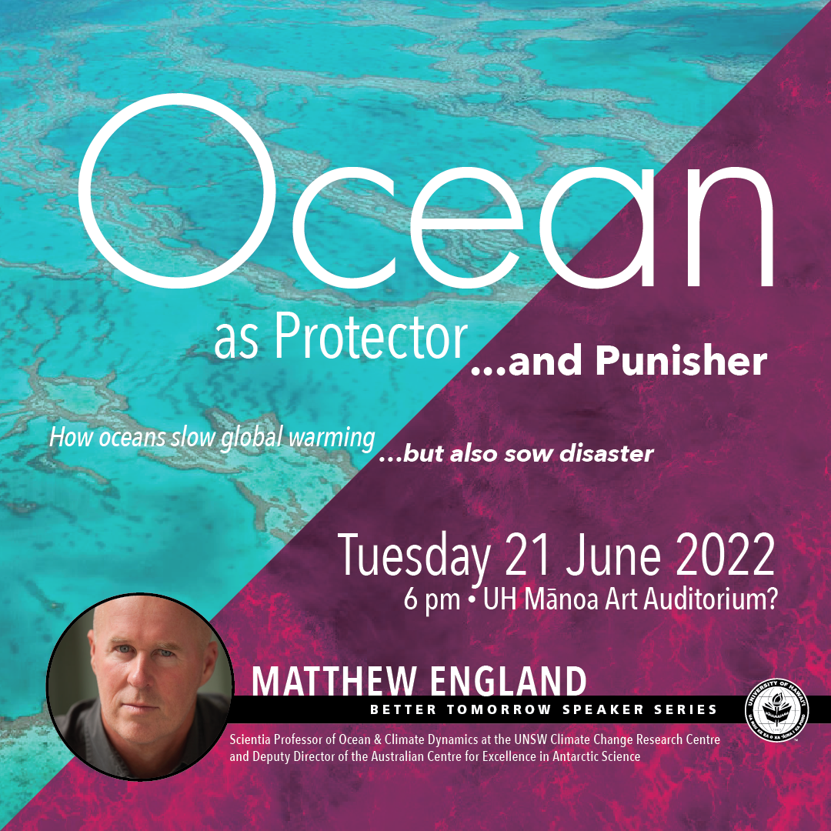
Hā O Ke Kai Collection
Climate change communication & collaboration across sectors
Watch on
Climate Ready Hawaiʻi: Coordinator’s Update. July 20, 2022 Meeting

Slide 4
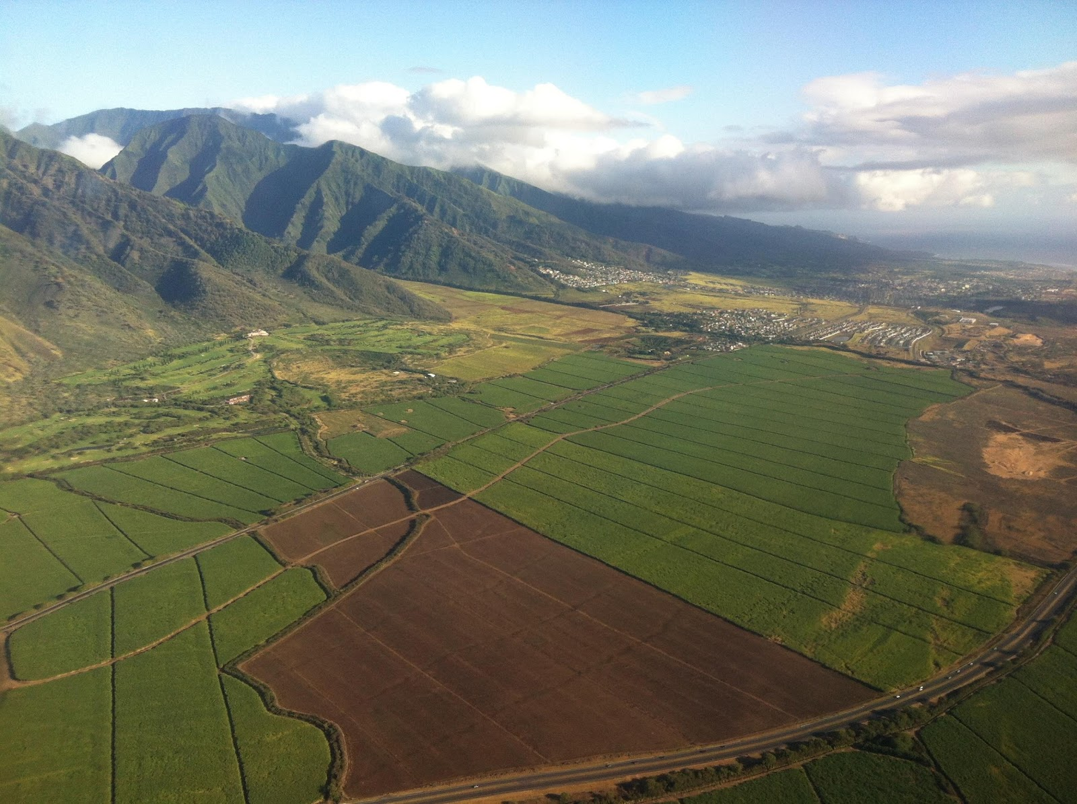
Act 185
The Hawaiʻi Carbon Smart Land Management Assistance Pilot Program
To incentivize carbon sequestration activities
through incentive contracts that provide
compensation for eligible practices by
program participants.
USCA Hawaiʻi NWL Research Team
Invasive species control
Afforestation
Interplanting, enrichment planting
Harvesting methods
Fire breaks
Nutrient management
Erosion control
Climate Ready Hawaiʻi: Coordinator’s Update. July 20, 2022 Meeting

Slide 5
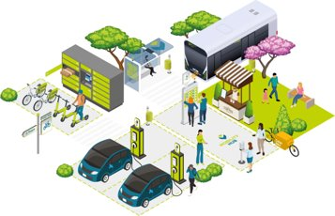
Mitigation
Oʻahu Mobility Hub Study
What is a Mobility Hub?
A place where people can seamlessly connect with multiple modes of transportation in a shared location
Provide physical integration among transportation modes by co-locating carshare, bikeshare, and other shared-mobility services close to public transit stops and dense residential developments
Scope of Work
Parking inventory and utilization rates
Classifications for potential sites
Evaluation criteria for site selection
Implementation strategies
Climate Ready Hawaiʻi: Coordinator’s Update. July 20, 2022 Meeting
Notes:
The Oahu Mobility Hub Study is being funded by an OahuMPO grant in collaboration with DOT and the HI Climate Commission. The study evaluates potential locations for mobility hubs on Oahu. A mobility hub is a place where people can connect with multiple modes of transportation in a shared location. It provides a physical space for the integration of modes like bikeshare, scooter share, TheBus, carshare, etc. The study will conduct a parking inventory and utilization analysis, develop classifications and evaluation criteria for site selection, and implementation strategies to help pilot mobility hubs to provide more sustainable transportation options. The scope of work and necessary paper work has been completed, and the project is kicking off later this week.

Slide 6
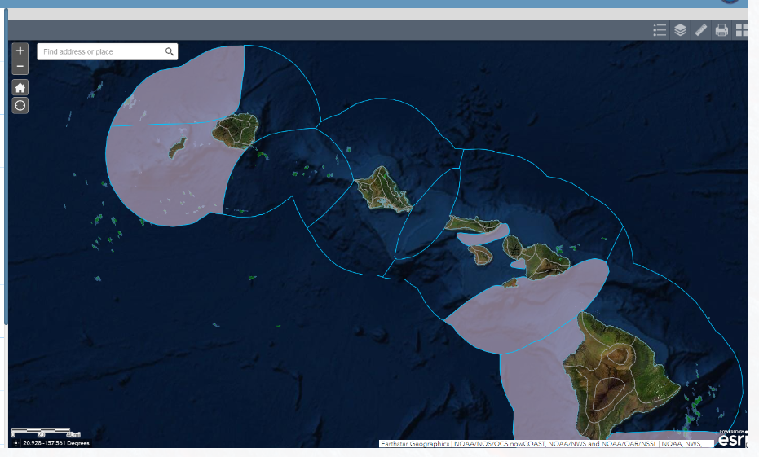
Climate Vulnerability Clearinghouse
White paper
Drafted by HIEMA and CCMAC Climate Ready Cohort
Tie in existing social vulnerability work and climate hazards for a comprehensive view on climate vulnerability in the state.
Next steps:
Review and feedback August 19th
Find Funding!
Climate Ready Hawaiʻi: Coordinator’s Update. July 20, 2022 Meeting

Slide 7
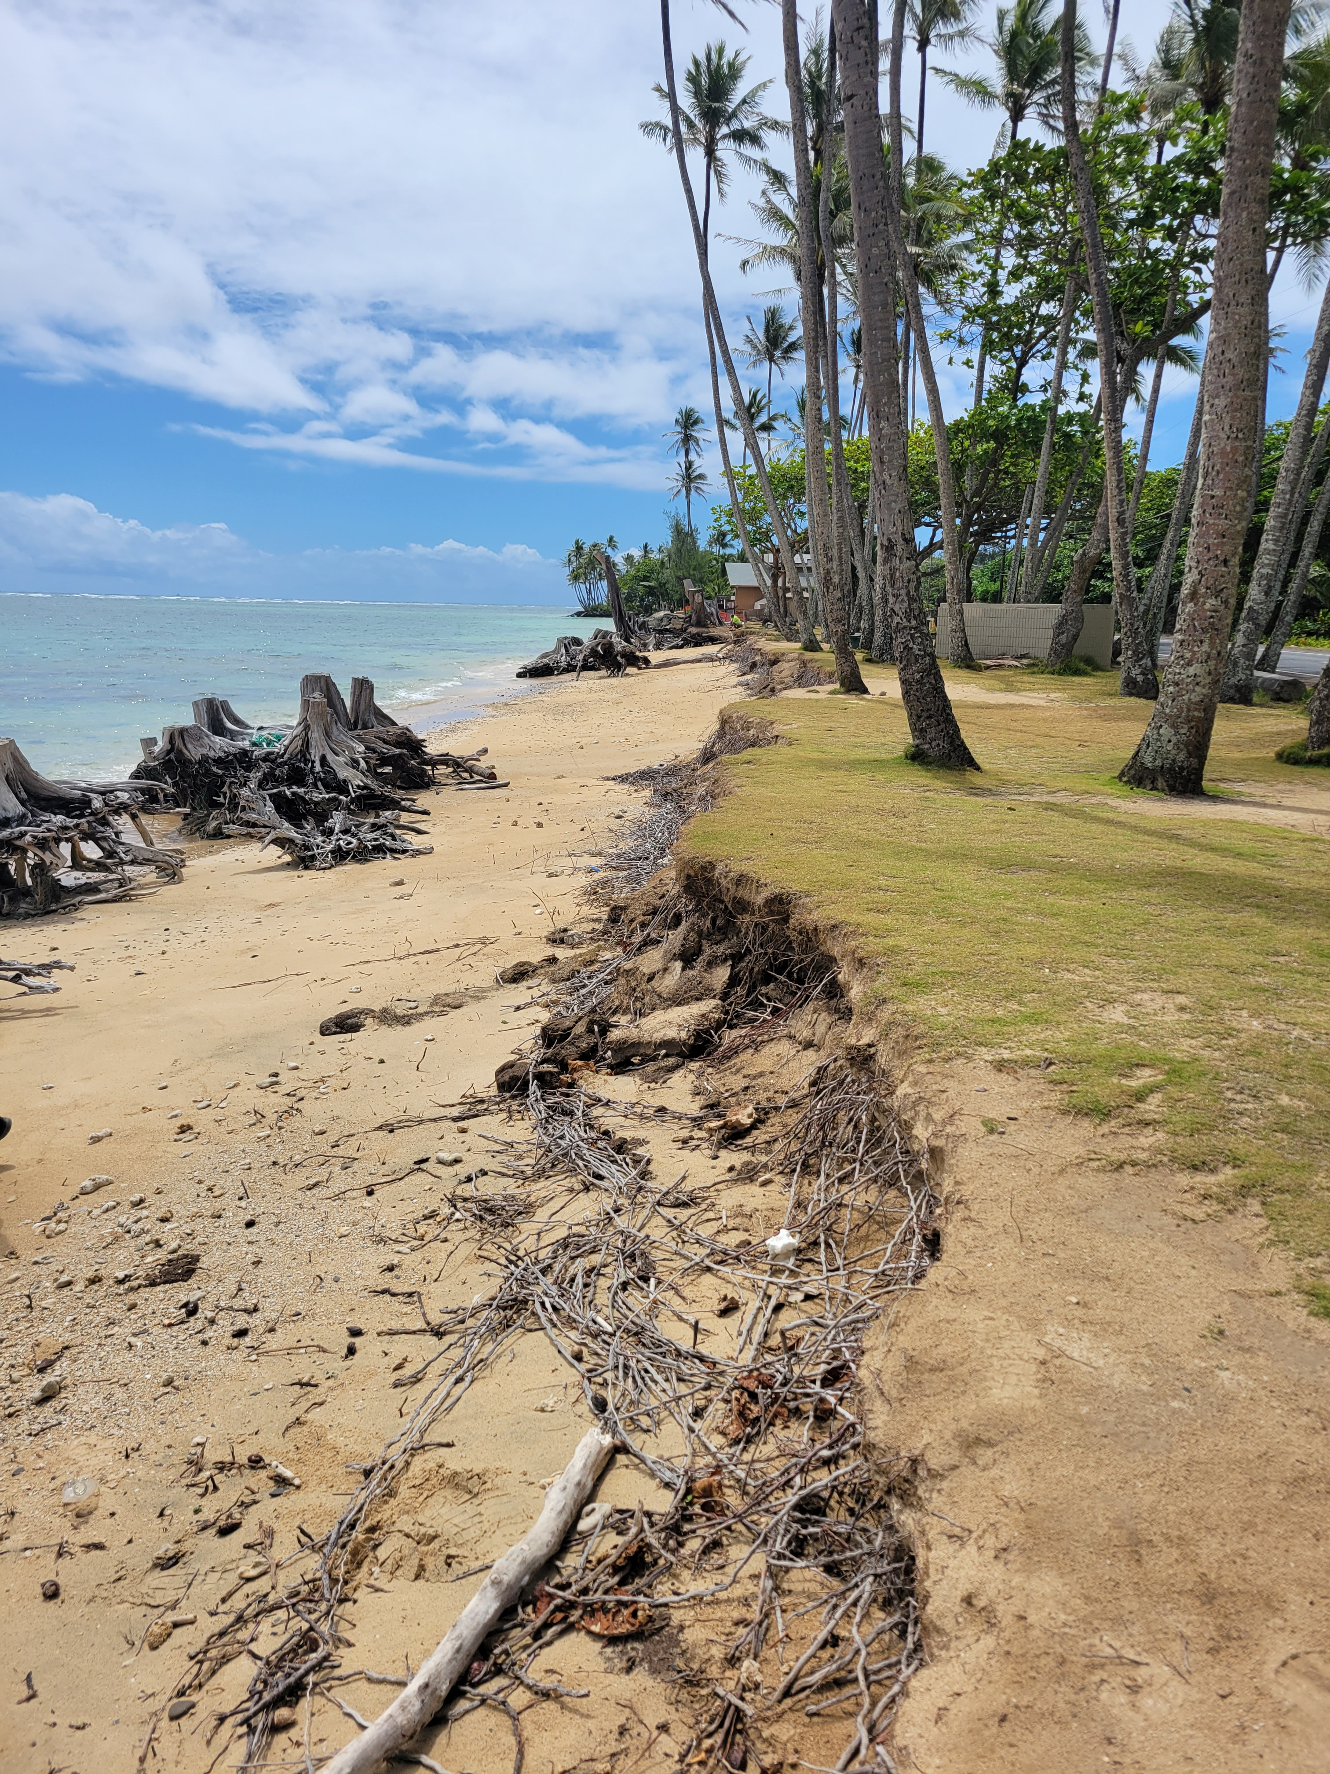
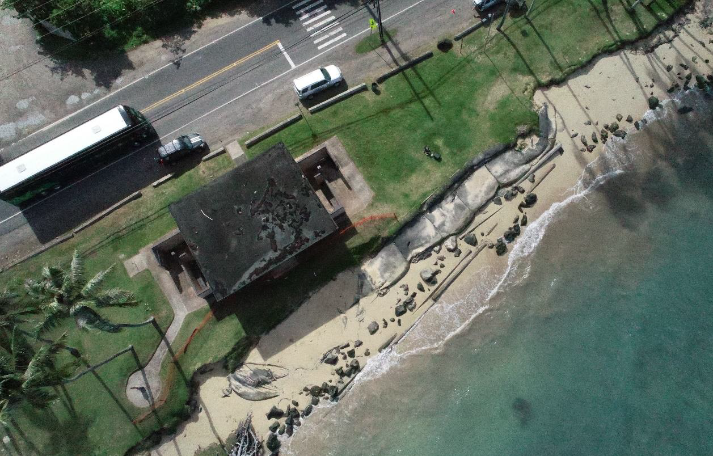
Adaption Punaluʻu Beach Restoration Project
Background: The Climate Commission, in coordination with DLNR (OCCL), HDOT, and Sea Grant, is contracting Sea Engineering to perform a feasibility assessment of nature-based solutions to erosion and sea level rise impacts at Punaluʻu Beach Park in Oʻahu.
In conjunction, the State is implementing a community engagement plan to consult with local residents and beach users
Notes:
The Hawaii Climate Change Commission, in coordination with the Office of Conservation and Coastal Lands with DLNR, Hawaii Department of Transportation, and Sea Grant, is contracting Sea Engineering to perform a feasibility assessment at Punaluu Beach Park of nature-based solutions to protect a critical section of Kamehameha Highway from flooding and erosion while also increasing resiliency to sea-level rise and coastal storms.
Shoreline erosion has narrowed the beach park such that shoreline vegetation is within fifty feet or less of the Kamehameha highway – threatening both the highway and community beach park. The park has ben identified as a key location for a demonstration project in protecting critical infrastructure, while also restoring and expanding a natural resource in the beach park to serve communities that use the park, as well as improve ecological resources.
On Tuesday, July 12, a team including OCCL, Sea Engineering consultants, Parks, a City representative, and the Climate Commission took a site visit to Kaawa and Punaluu Beach Parks. There was a clear juxtaposition in the situations between Kaawa, where the beach was highly eroded and the situation was more dire in threatening the highway, such that reventments were prioritize to protect the highway, versus Punaluu Beach Park, where although there was clear signs of erosion, the Beach Park was still a viable location for beach restoration as a strategy to protect the highway. In interviews with Parks representatives – both parks were well trafficked during peak recreational hours by visitors and residents. Punaluu was also identified as a source of high significance to local families, as it was where local residents scattered ashes of loved ones.
The Punaluu Beach Park restoration project is an ideal project for prioritizing and serving community values, protecting a valuable ecological and recreational resource, while protecting critical infrastructure.
As part of this feasibility assessment project, the State is also launching a community engagement plan to consult with local residents, beach users, and other relevant stakeholders to capture and report community priorities in conjunction with the feasibility assessment. The goals of the plan is to share information and increase public awareness of nature-based solutions to sea-level rise and other climate change impacts to coastal erosion, to consult with community to incorporate their priorities for Punaluu, and to enhance collaboration and communication overall, in order to build capacity for future coastal resilience projects to protect Hawaii’s communities. The Climate Commission is currently drafting out a community engagement scope of work, to be implemented during the feasibility assessment.
Partnerships, lessons learned, and methods employed through this project may be applied to many other vulnerable lengths of shorefront highway on Oʻahu and statewide.

Slide 8
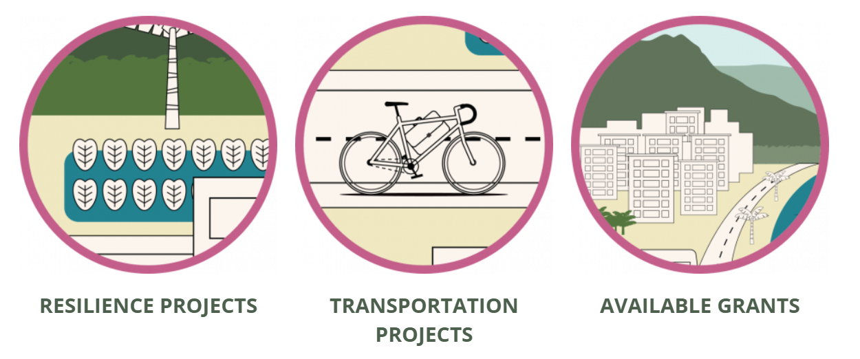
IIJA/BIL CROSSWALK G2P BRIDGE
Climate Ready Hawaiʻi Vista Cohort
Reaching out to build out our list of resilience and Transportation projects and sharing grant opportunities for listed projects.
Climate Ready Hawaiʻi: Coordinator’s Update. July 20, 2022 Meeting

Slide 9
Justice 40 Indicators
Climate Ready Hawaiʻi: Coordinator’s Update. July 20, 2022 Meeting

Slide 10
Hawaiʻi Conservation Conference
Kākoʻo Aniau
Thursday, 21 July, 2022
8:00-10:00am
Synergizing climate mitigation and adaptation in Hawaiʻi
Hawaiʻi Conservation Alliance
USDA Forest Service
Seek ideas and input on how to better coordinate knowledge exchange.
Goal is to create a coordinating structure for Hawaiʻi that serves the diverse organizations that engage in climate adaptation and mitigation.
Climate Ready Hawaiʻi: Coordinator’s Update. July 20, 2022 Meeting

Slide 11
New Meeting Date!
October 19, 2022
Climate Ready Hawaiʻi: Coordinator’s Update. July 20, 2022 Meeting

Slide 12
Contact Information
Leah Laramee
Hawaii Climate Change Mitigation and Adaptation Coordinator
Email: Leah.J.Laramee@Hawaii.gov
Phone: 808-895-1477
Website: climate.Hawaii.gov
Instagram: @Hi_Climate
Facebook: @Hi Climate
Jan–May
2018
Sep–Dec
2017

