Slide 1
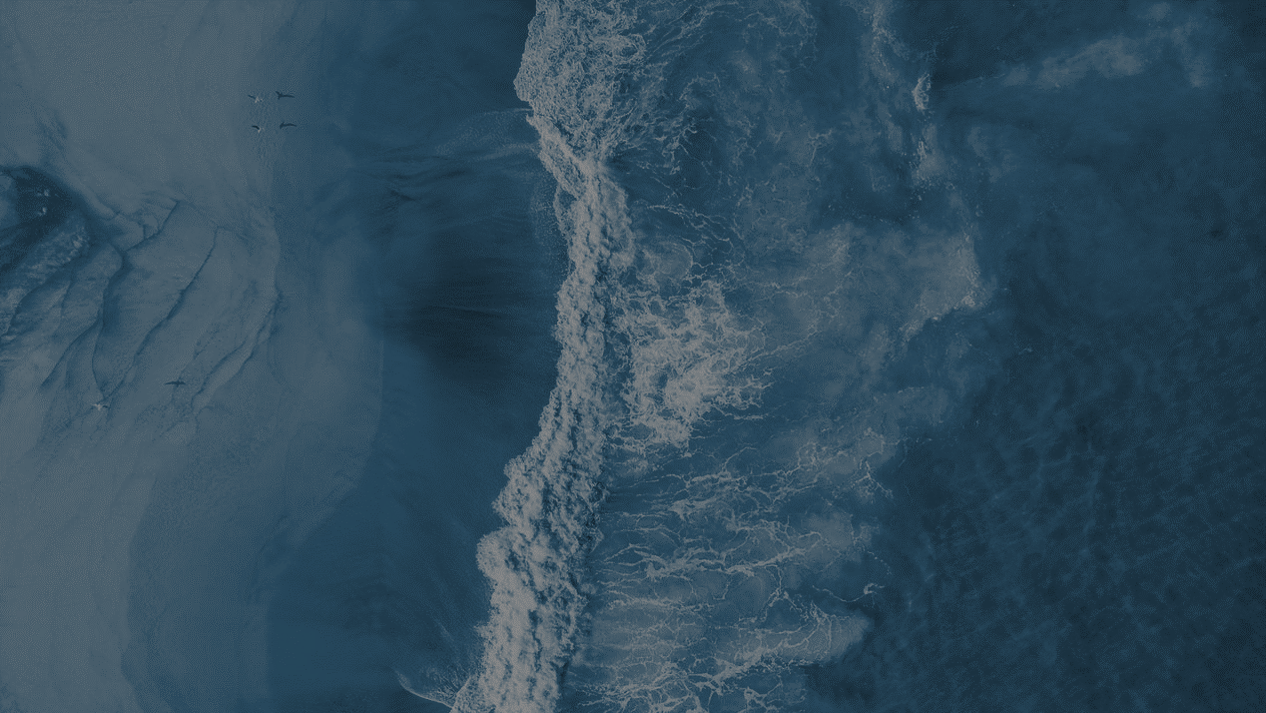
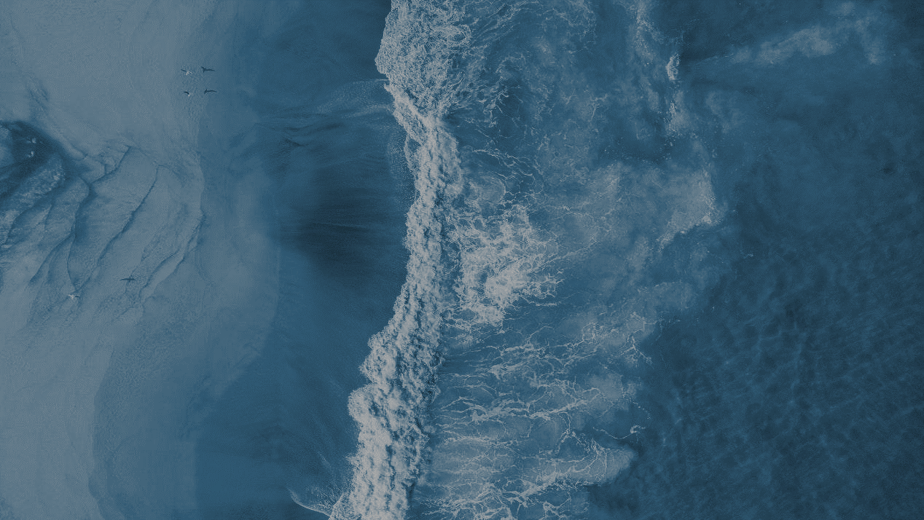
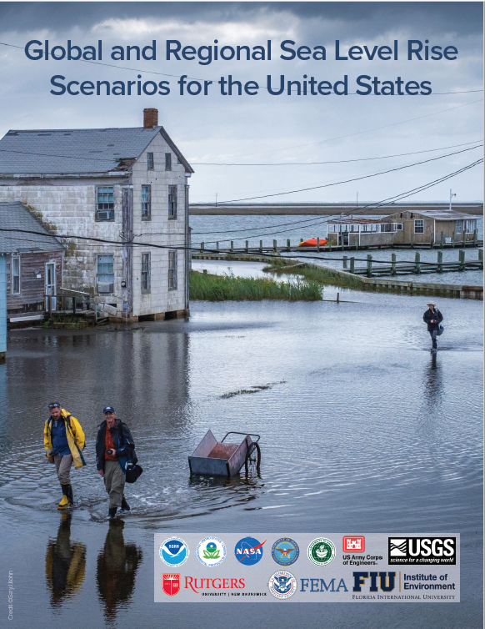
Global and Regional Sea Level Rise Scenarios
for the United States:
Updated Mean Projections and
Extreme Water Level Probabilities Along U.S. Coastlines
William Sweet/NOAA, Ben Hamlington/NASA JPL
Robert E. Kopp/Rutgers, Christopher P. Weaver/EPA, Patrick L. Barnard/USGS David Bekaert/NASA JPL, William Brooks/NOAA, Michael Craghan/EPA, Gregory Dusek/NOAA, Thomas Frederikse/NASA JPL, Gregory Garner/Rutgers, Ayesha S. Genz/Uni of Hawaii, John P. Krasting/NOAA, Eric Larour/NASA JPL, Doug Marcy/NOAA, John J. Marra/NOAA, Jayantha Obeysekera/Florida International, Mark Osler/NOAA, Matthew Pendleton/NOAA, Daniel Roman/NOAA, Lauren Schmied/FEMA, Will Veatch/U.S. Army Corps of Engineers, Kathleen D. White/U.S. Department of Defense, Casey Zuzak/FEMA

Slide 2
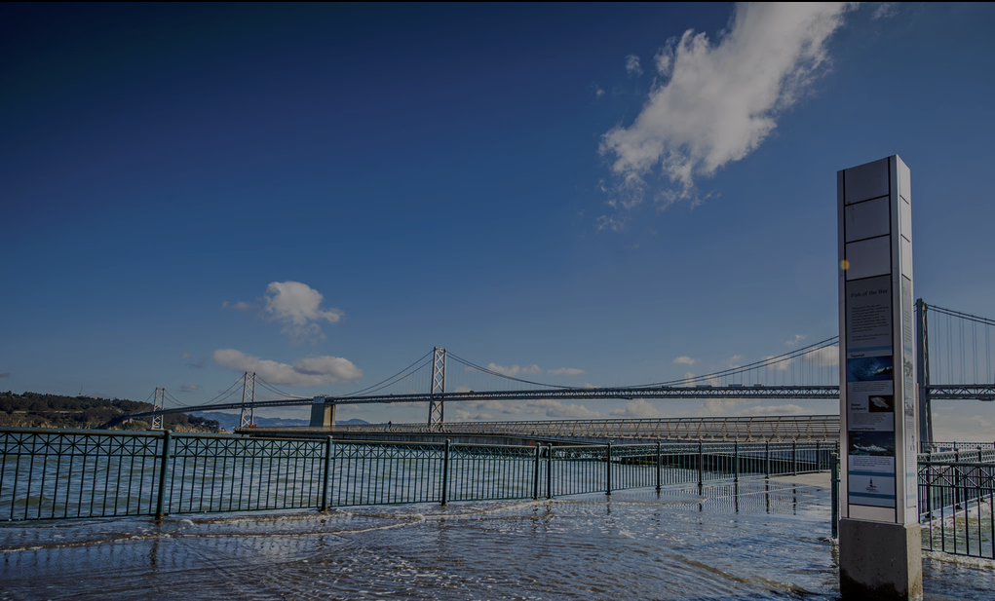
Interagency Sea Level Rise and Coastal Flood Hazard Scenarios and Tools Task Force
The “Sea Level Rise and Coastal Flood Hazard Scenarios and Tools Interagency Task Force” was convened at the direction of the White House Resilience Council, in 2015, jointly under USGCRP, SOST, and the National Ocean Council (NOC)
After formation, the Task Force developed a set of coordinated, federal, global and regional SLR scenarios as input to NCA4 and to agency coastal tools and planning processes
These new scenarios were published in a 2017 report, incorporated into NCA4 Vols I and II, and disseminated widely through existing agency and interagency web portals
San Francisco, CA (http://california.kingtides.net/)
Notes:
What, and who, is the report for:
This multi-agency effort provides updated SLR projections for all U.S. states and territories, representing the first update since 2017
A key technical input to the 5th National Climate Assessment
Intended to support the provision of accessible and useable SLR and coastal flood hazard information to serve as a starting point for federal, state, local, tribal, and territorial efforts to plan for and adapt to SLR impacts

Slide 3
Interagency Sea Level Rise and Coastal Flood Hazard Scenarios and Tools Task Force
New report (2022) builds upon the 2017 report:
Focuses on (i) rise by 2050 and scenarios considered ‘plausible’ by 2100 and beyond for risk framing purposes
Provides (ii) extreme water level probabilities for U.S. coastlines to (iii) assesses flood risk in coming decades if no action is taken
San Francisco, CA (http://california.kingtides.net/)
Notes:
What, and who, is the report for:
This multi-agency effort provides updated SLR projections for all U.S. states and territories, representing the first update since 2017
A key technical input to the 5th National Climate Assessment
Intended to support the provision of accessible and useable SLR and coastal flood hazard information to serve as a starting point for federal, state, local, tribal, and territorial efforts to plan for and adapt to SLR impacts

Slide 4
(1) U.S. Sea Level Rise (SLR) Scenarios
What’s in this report?
SLR Scenarios for U.S. at regional (1-degree gridded) and local level (tide gauges) from 2020 to 2150
Trajectories of SLR from 2020 to 2050 based on tide gauge observations from 1970-2020
What’s new?
Scenarios updated using science from IPCC 6th Assessment Report
Comparisons of models vs. tide gauge and altimeter observations
Increased focus on near-term time period (2020-2050)

Slide 5
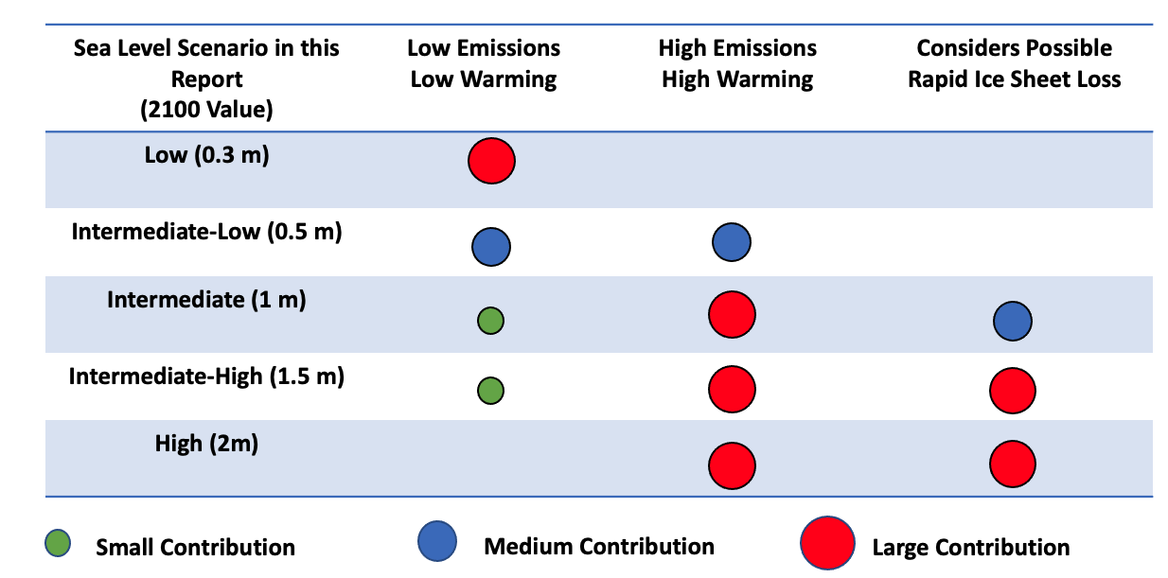
What are the U.S. SLR Scenarios?
Cover plausible range of future global SLR
Incorporate future emissions, warming and our current scientific understanding
5 scenarios, from Low to High (0.3 to 2 m by 2100)
Notes:
What are the GMSL Scenarios?
The scenarios are designed to cover the range of “plausible” future sea level rise.
Defined by target values of GMSL rise by 2100.
Pathways from 2020-2150 are generated using models.
Regionalized to provide scenarios on regional and local level.
Consistent with IPCC 6th Assessment Report.
In this report, for the first time, we also assess the trajectory of near-term sea level rise from NOAA tide gauge observations. Important comparison for model-based scenarios and additional line of evidence.

Slide 6
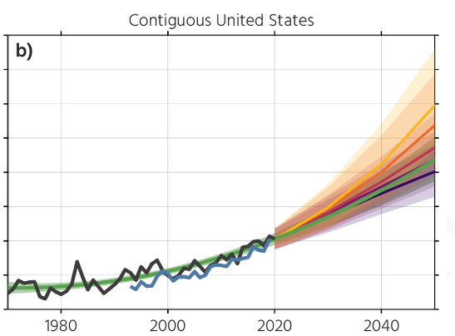
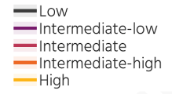
U.S. (relative) sea levels expected to be 10 - 12 inches higher (on average) in the next 30 years (2020-2050)
Key Takeaways
Equals the rise from last 100 years (1920-2020)
Observations agree with models, tracking Int-low/Int.
Smaller range across scenarios (emission/temperature) pathways

Slide 7
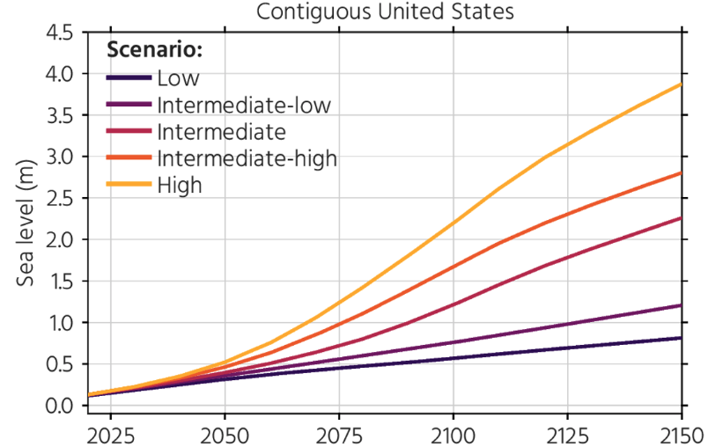
Higher global temperatures increase the risk of SLR in 2100 and beyond
Key Takeaways
Scenario Ranges Relative to 2000:
2100: 0.6 - 2.2 m (2 – 7 ft)
2150: 0.8 - 3.9 m (2.5 – 12 ft)
Ranges from future emissions and response of Earth systems (need to monitor)
Notes:
Possible instabilities in the ice sheets could lead to much larger increases in sea level rise 🡪 still uncertain how ice sheets will respond to future warming but we need to monitor.
Estimates vary along the U.S. coastlines, but story is same: more warming 🡪 more sea level rise.

Slide 8
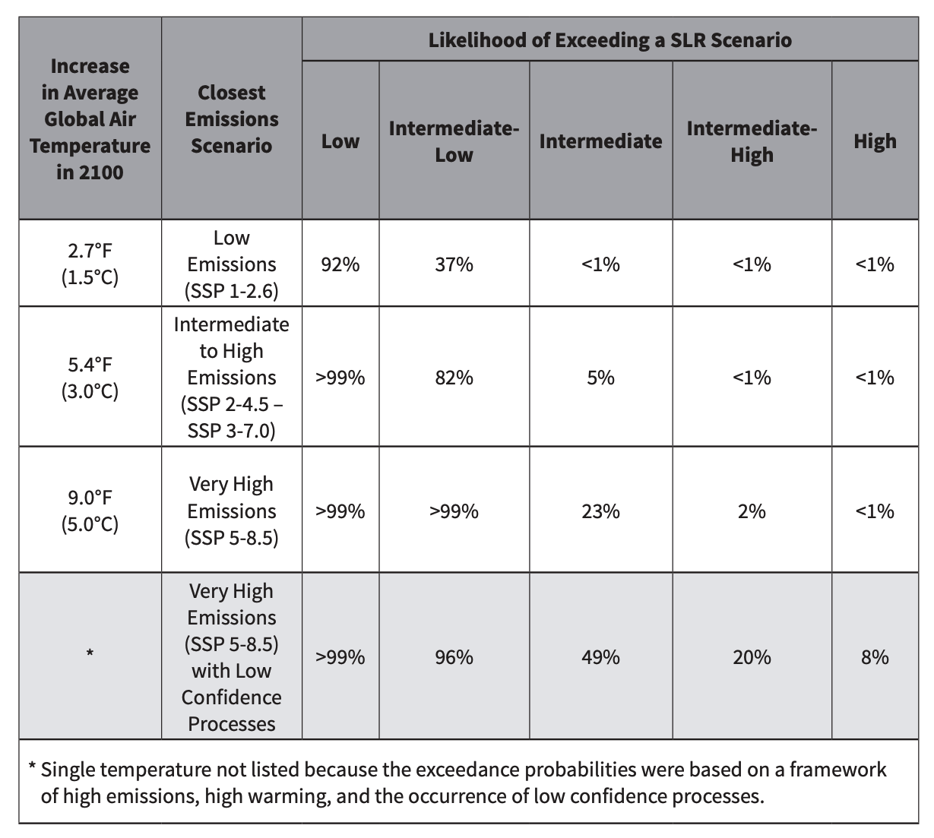
Higher global temperatures increase the risk of SLR in 2100 and beyond
This table shows the probability, or likelihood, of exceeding the associated global SLR scenario by 2100 under a range of different temperature and related emissions scenarios
Table from “Application Guide for the 2022 Sea Level Rise Technical Report” (Collini, Carter, et al., 2022).
Notes:
Possible instabilities in the ice sheets could lead to much larger increases in sea level rise 🡪 still uncertain how ice sheets will respond to future warming but we need to monitor.
Estimates vary along the U.S. coastlines, but story is same: more warming 🡪 more sea level rise.

Slide 9
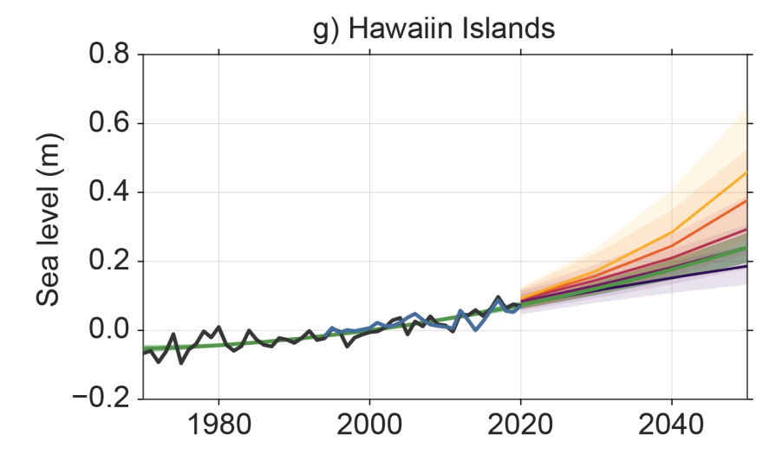
Scenarios for the Hawaiian Islands
Key Takeaways
Scenario Ranges Relative to 2000:
2050: 0.20 – 0.46 m (0.6 – 1.5 ft)
2100: 0.4 – 2.4 m (1.2 – 7.9 ft)
2150: 0.5 – 4.3 m (1.7 – 14.1 ft)
Observations tracking Intermediate Low towards 2050.
Notes:
Possible instabilities in the ice sheets could lead to much larger increases in sea level rise 🡪 still uncertain how ice sheets will respond to future warming but we need to monitor.
Estimates vary along the U.S. coastlines, but story is same: more warming 🡪 more sea level rise.

Slide 10
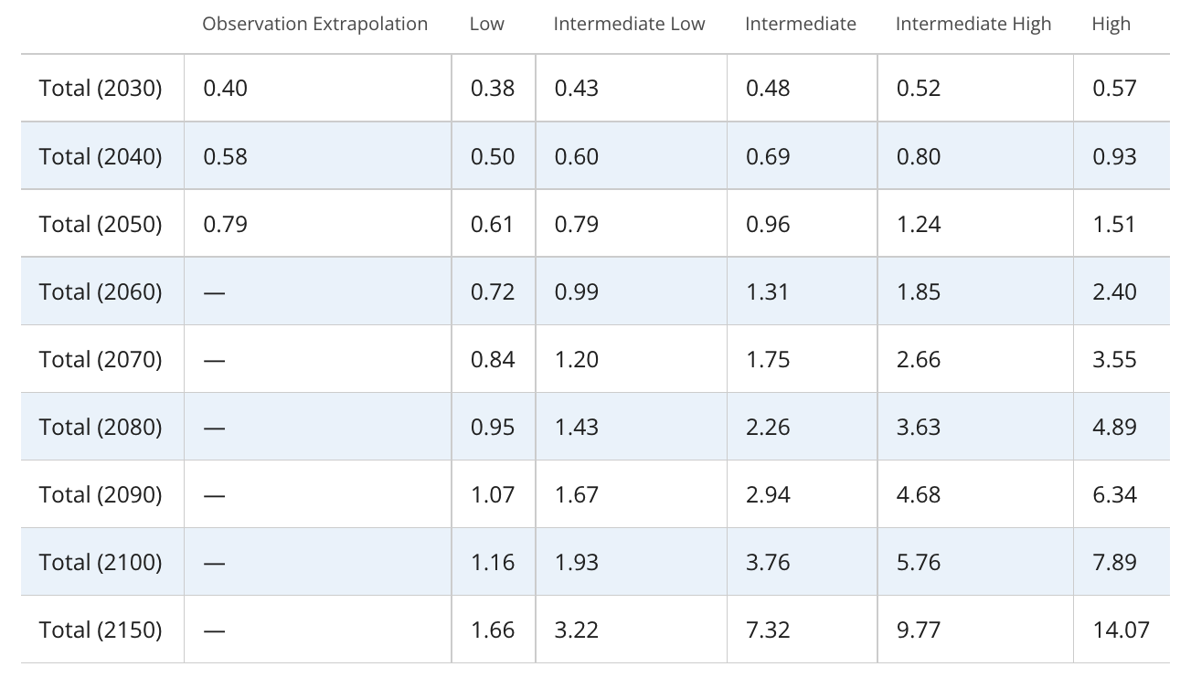
Scenarios for the Hawaiian Islands (ft relative to 2000)
Notes:
Possible instabilities in the ice sheets could lead to much larger increases in sea level rise 🡪 still uncertain how ice sheets will respond to future warming but we need to monitor.
Estimates vary along the U.S. coastlines, but story is same: more warming 🡪 more sea level rise.

Slide 11
Summary Messages
Because of updates to the ice sheet projections that indicate the possible onset of rapid ice sheet loss occurring further into the future:
The ”Extreme” scenario has been removed.
There is a smaller range between scenarios in near-term.
Observations are consistent with Intermediate-Low to Intermediate scenarios across regions.
There is rapid divergence of scenarios beyond 2100.
Notes:
Possible instabilities in the ice sheets could lead to much larger increases in sea level rise 🡪 still uncertain how ice sheets will respond to future warming but we need to monitor.
Estimates vary along the U.S. coastlines, but story is same: more warming 🡪 more sea level rise.

Slide 12
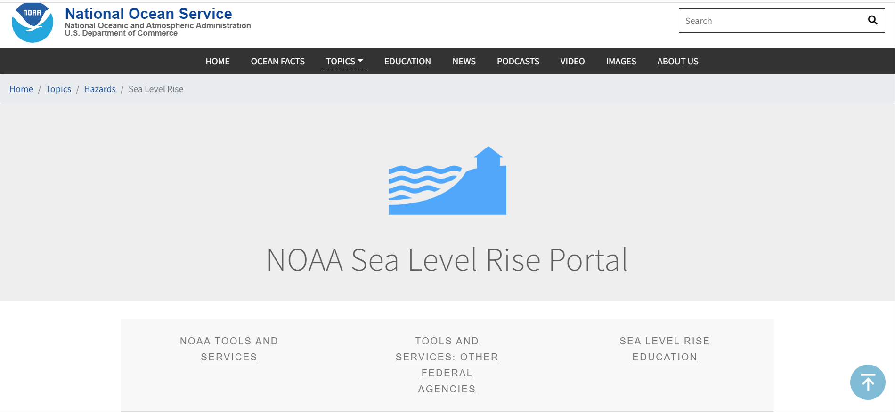
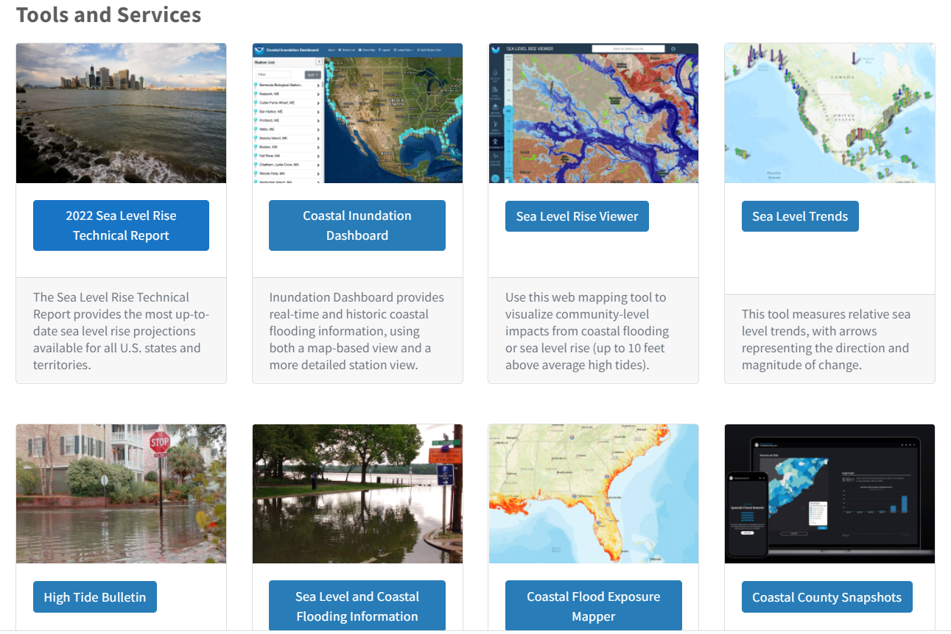
Access to Report Content - NOAA
Notes:
*add other agencies’ leg contacts

Slide 13
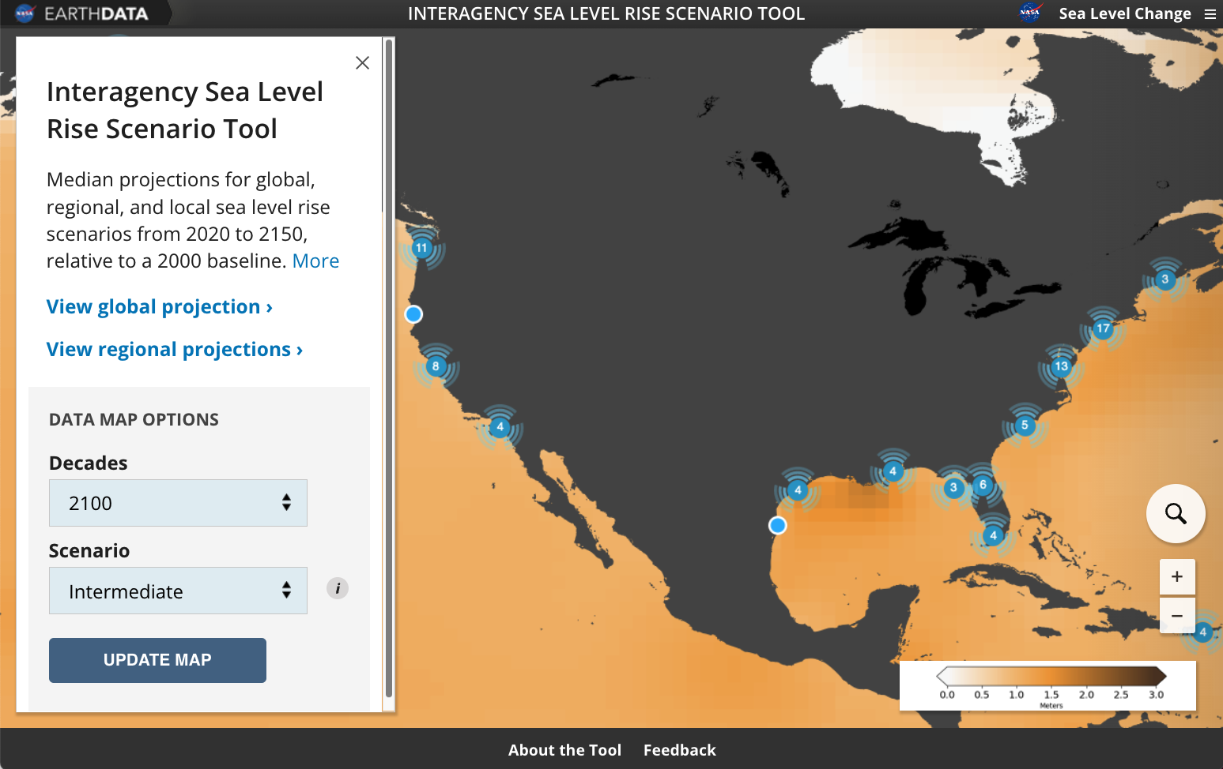
Access to Report Content - NASA
Through the NASA Sea Level Change Team, a delivery tool for the scenarios in the report was created and delivered alongside the report.
Provides easy visualization of the scenarios and access to the underlying data.
Co-developed with U.S.-based practitioners and continue to integrate feedback of users.
Over 50,000 unique users of the tool since launch.
https://sealevel.nasa.gov/task-force-scenario-tool
Notes:
*add other agencies’ leg contacts

Slide 14
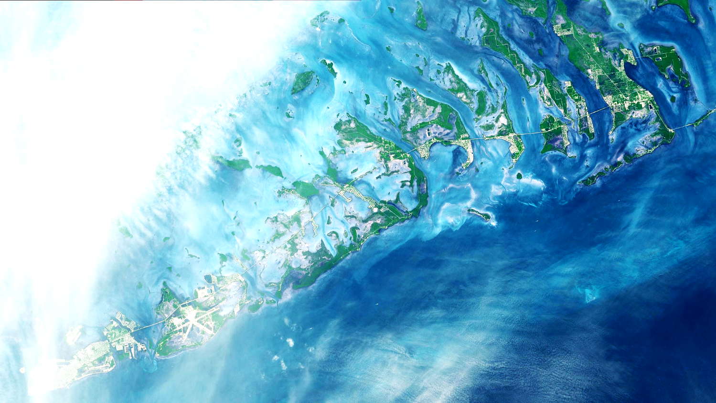
Agency Websites: NOAA https://oceanservice.noaa.gov/hazards/sealevelrise/sealevelrise-tech-report.html NASA https://sealevel.nasa.gov/task-force-scenario-tool Contacts:
William Sweet (william.sweet@noaa.gov) Ben Hamlington (Benjamin.D.Hamlington@jpl.nasa.gov)

