Slide 1

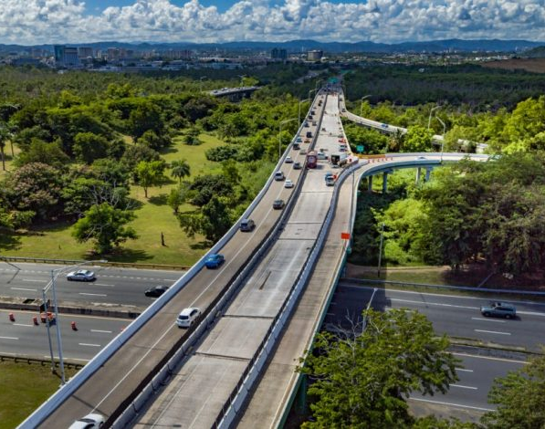
Roadway Expansions and Vehicle Miles Traveled
Hawaii Climate Change Mitigation
& Adaptation Commission
April 6, 2022
Notes:
Brief intro on background both at RMI and funding work, for small and large communities alike.
Thanks for giving us the opportunity to present the SHIFT Calculator. This work came out of a successful partnership between the Urban Transformation team and the US Program. In comparison to other projects, it was initially a very small project. Funded internally, with a quick turn around. But its impact has been much larger than we anticipated. And it continues to make an impact in the transportation space. I'll kick it over to Zack Subin and Lainie Rowland from the US Program to provide some more background.

Slide 2
Urban Transformation: How we work
Action-provoking
thought leadership
Practical tools
Direct city support
City cohorts
RMI staff in handful of climate critical cities and key central government agencies to drive
signature initiatives
Influence through access to expertise and financing
Remote technical assistance and analytical support to help cities
adopt or advocate for critical policy
Aggregate advocacy and buying power
Address critical knowledge gaps on urban decarbonization
e.g., VMT reduction, nature-based solutions, urban cooling, climate intelligence
Open access, user-friendly tools and resources aimed at city staff making daily operational and procurement decisions
e.g., SHIFT calculator, RESET (residential solar calculator)…
Notes:
We offer intensive support in the form of embedded staff in a handful of climate-critical cities. Their job is to drive signature climate initiatives that can serve as powerful examples. Not in the easy places (Stockholm or Copenhagen or Amsterdam) but in the places where it’s really hard (Houston, Delhi)
We use a cohort model—that we’ve been continually refining over the last 3 years—that enables our lean team to deliver intensive technical assistance to up to 30 cities at a time. (RMI has invested a lot in building capabilities in complex, multistakeholder facilitation—in bringing cities, national governments, industry, and community groups together to co-create solutions)
We develop analytically rigorous thought leadership that inspires action, highlighting critical but neglected or misunderstood climate solutions.
We develop open access, practical tools, and resources aimed at city staff making daily operational and procurement decisions (not high-level planning or greenhouse gas inventories).

Slide 3
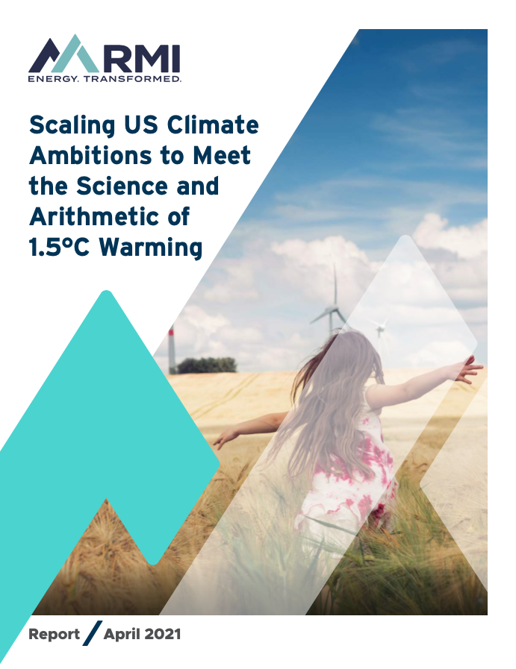

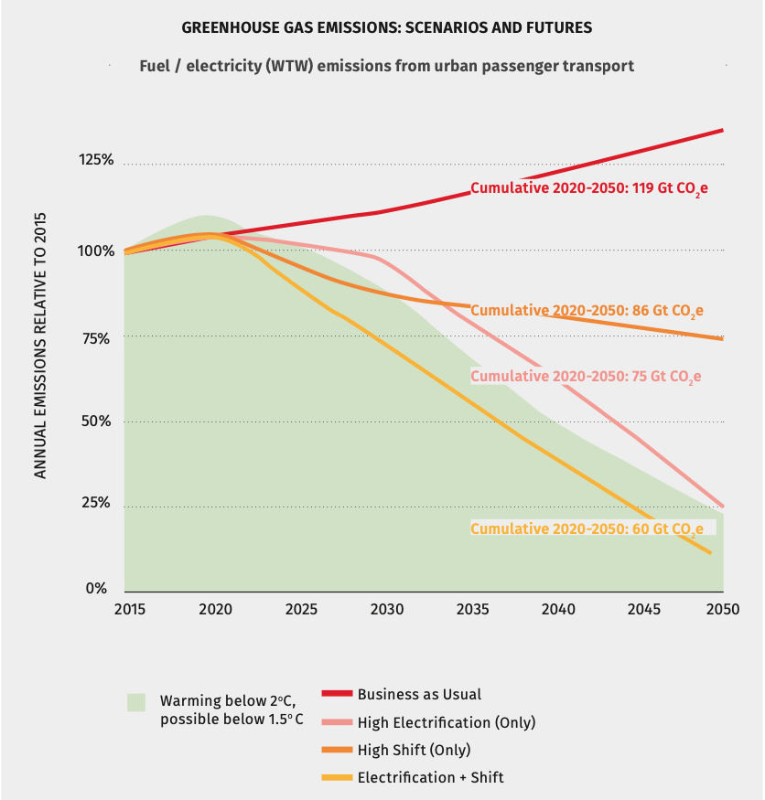





RMI analysis shows the US cannot meet 1.5° ambitions without shifting the amount we drive or where we build
For this line you need to electrify transportation AND mode shift
ITDP: ”The Compact City Scenario- Electrified” (2021)
Notes:
-Recently our colleagues at UC Davis and ITDP put out a nice global report showing that you can’t fit transportation into a 1.5C cumulative emissions budget with either electrification or VMT reduction alone: you need both. [Describe graphic] And there has been growing academic literature making this point.
-The US, UT, and CFM teams came to the same conclusion a year ago, and we worked together to emphasize strong targets for both EVs and VMT reduction in our US 1.5C report.
-But communicating the need is only a first step. We need to help policymakers map out strategies to reduce VMT.
-In principle, the easiest step is to stop spending money to make the problem worse by expanding highways! This is top of mind for our state advocacy and now with hundreds of billions of federal dollars incoming.

Slide 4
Cities can reduce VMT 20% using these 5 strategies
Vehicle Miles Traveled (Billions)
10%
5-20%
3,200
5-15%
Conservative VMT Estimate 2030
8% Reduction (2,944)
1-3%
3-6%
4-8%
Aggressive VMT Estimate 2030
42% Reduction (1,856)
Source: https://rmi.org/our-driving-habits-must-be-part-of-the-climate-conversation/
Notes:
Use choice language – “alternatives to vehicle ownership” not mainstream.
Use “roadway” instead of highway
Reference conversation with Georgetown Climate Center
Our research has shown that there are at least 5 ways we can make progress on our VMT reduction target of 20% by 2030.
- Build more housing, and build it next to places people need to get to
- Correctly price the use of the road and the ownership of vehicles
- Stop expanding highways – and maybe, start to remove them
- Redesign the streets to prioritize buses, walking, and rolling
- Implement transportation demand management measures, like teleworking

Slide 5
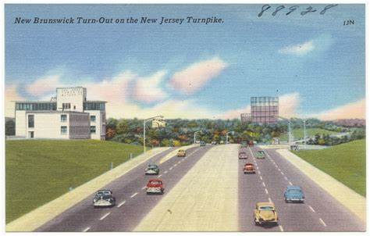
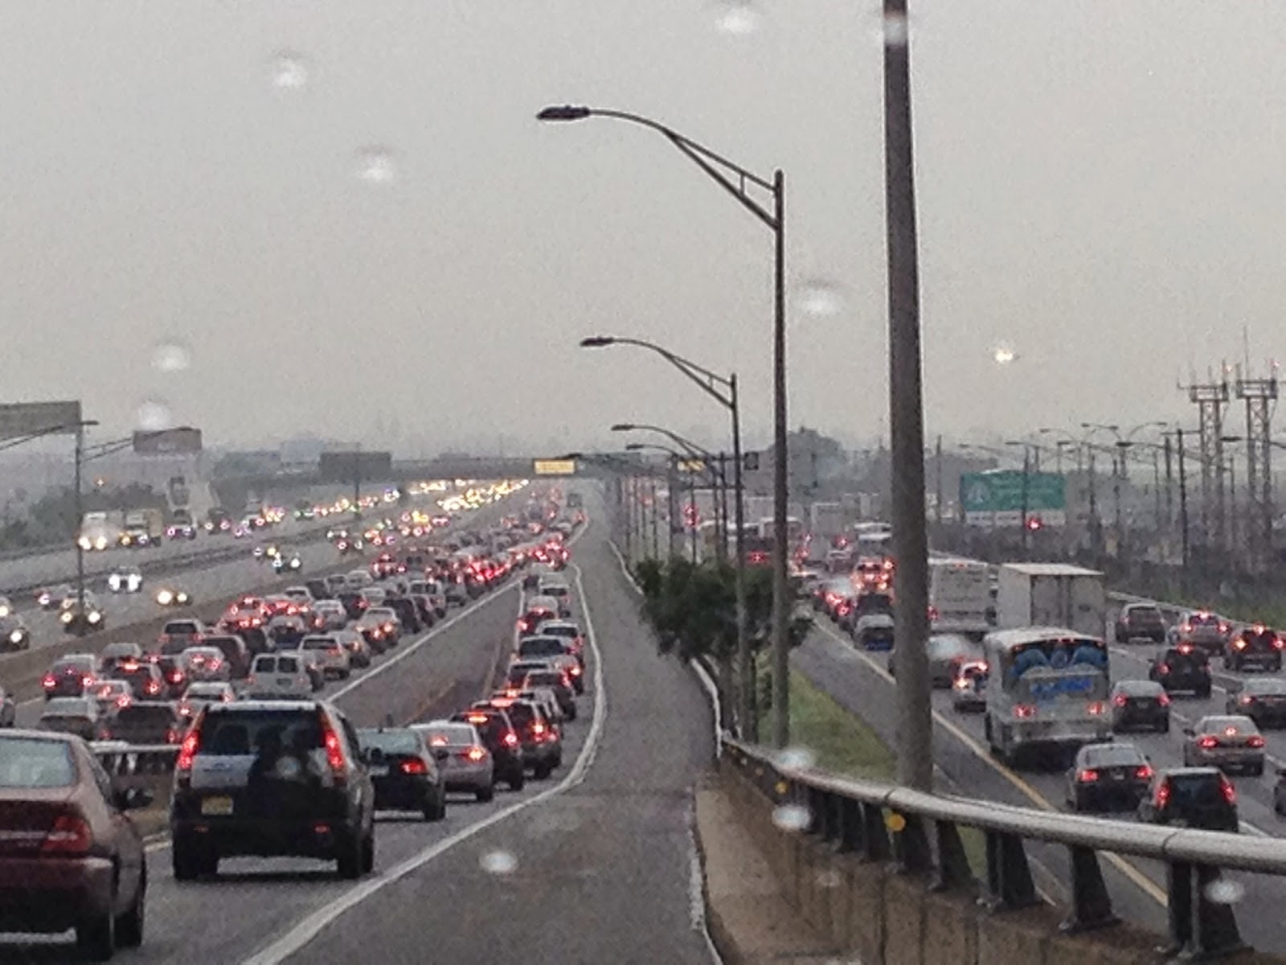
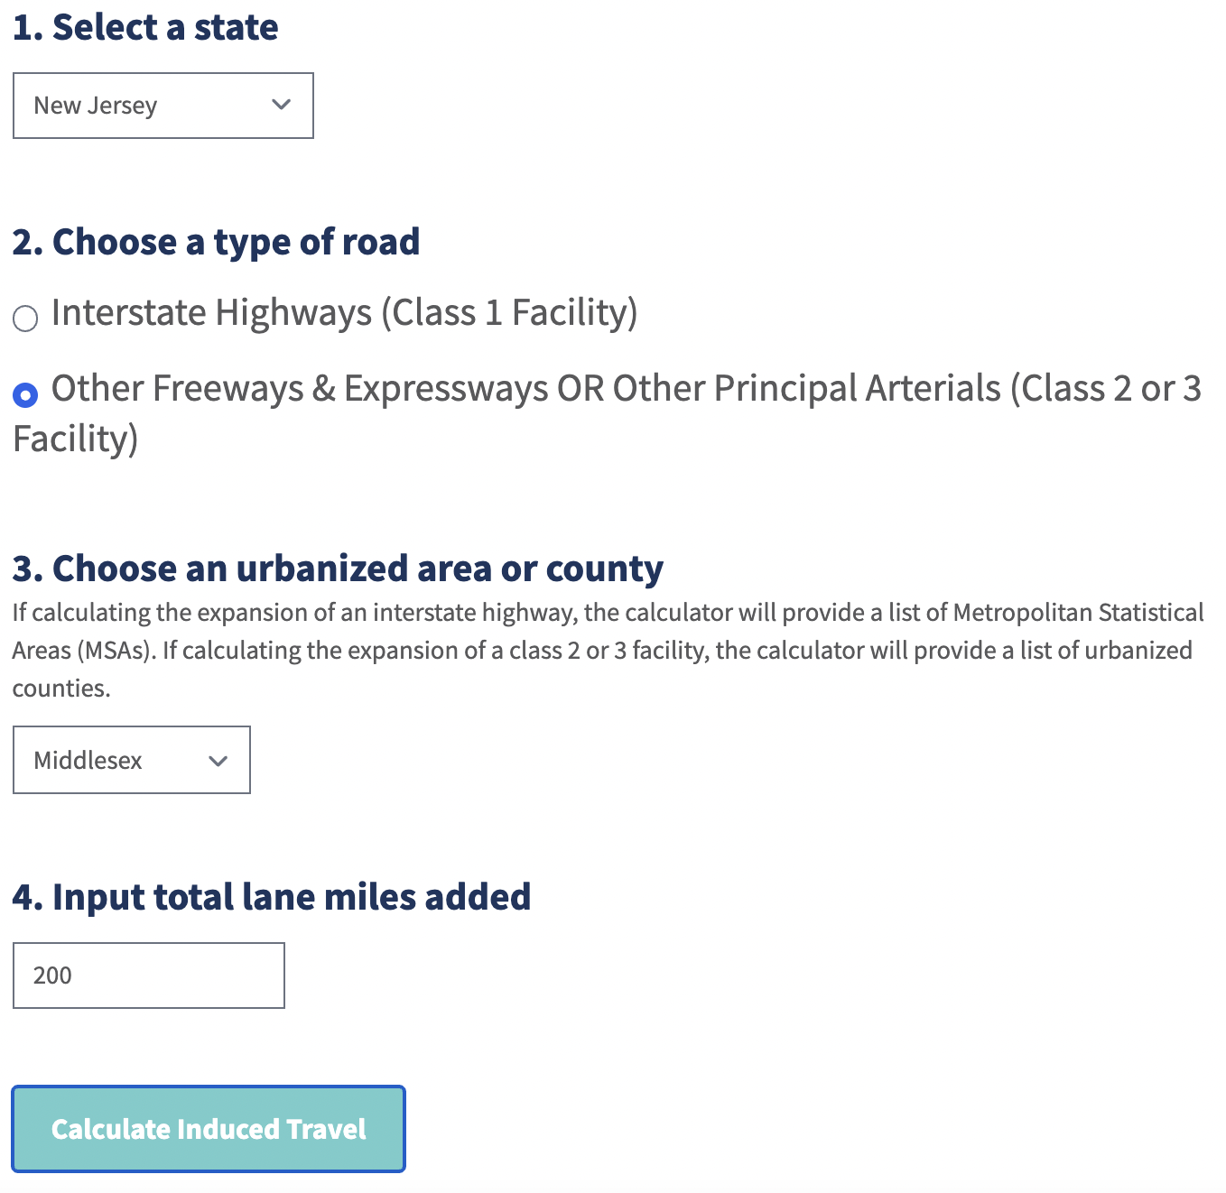
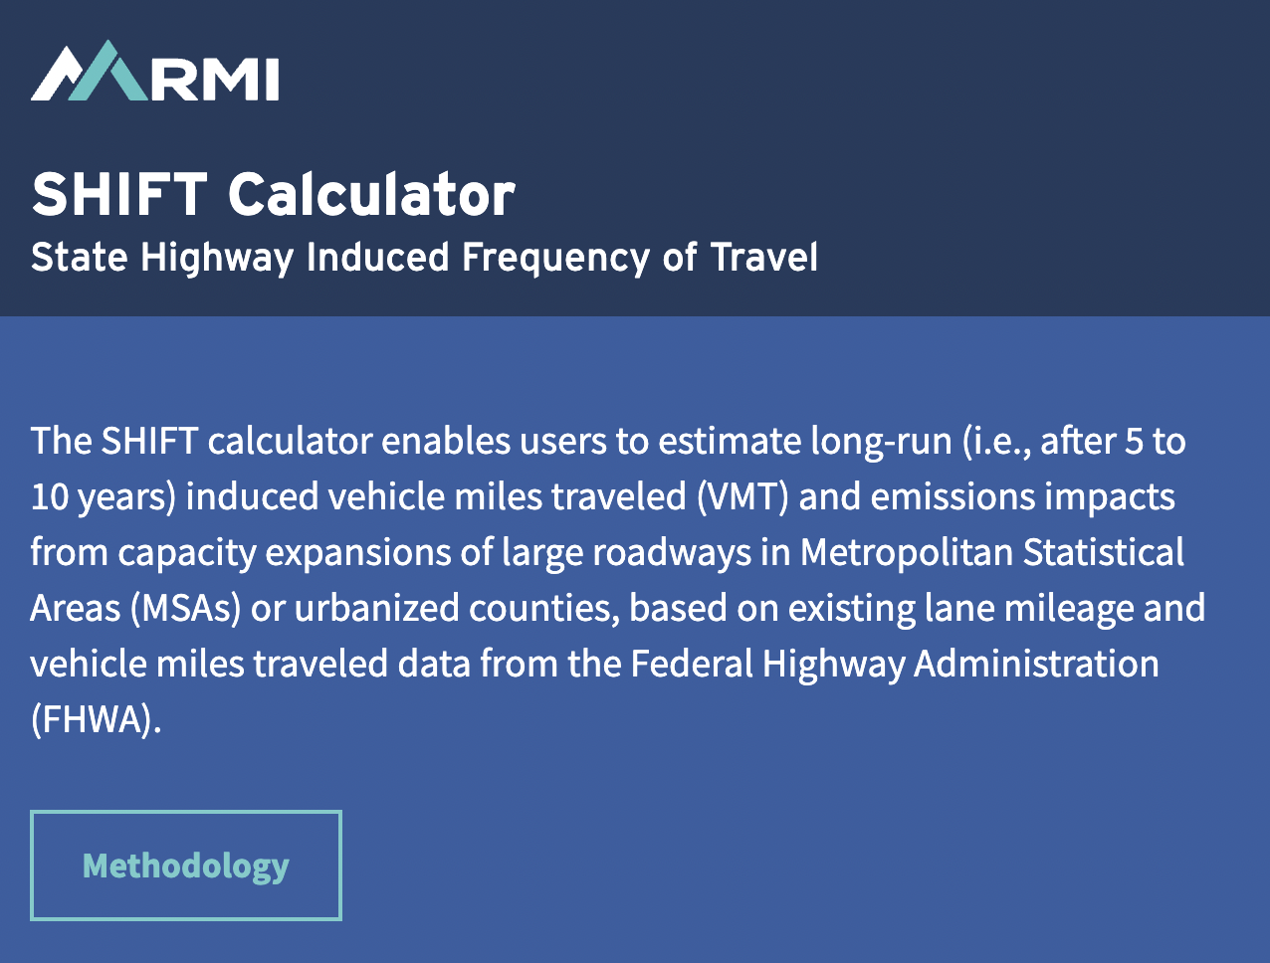
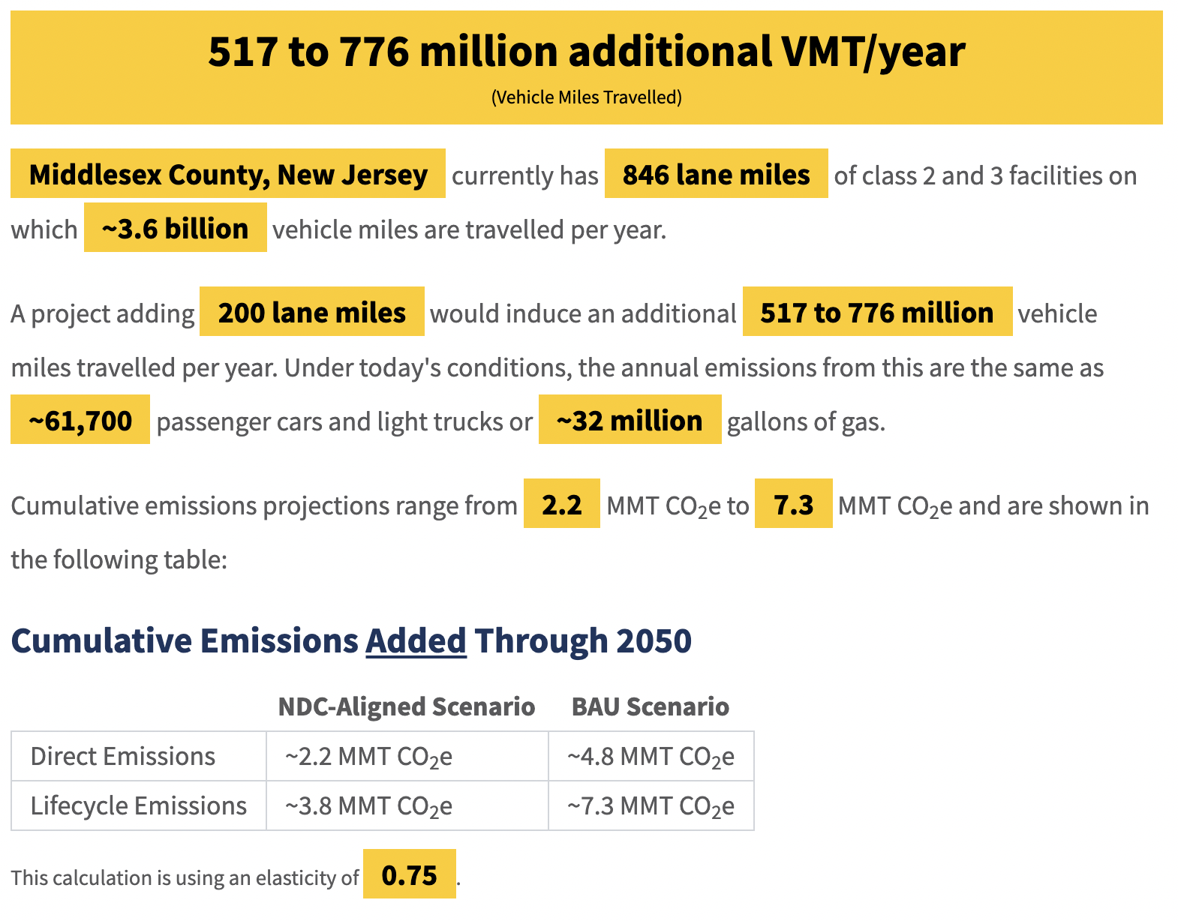
Evaluating proposed roadway expansion projects
Notes:
Discuss methodology

Slide 6
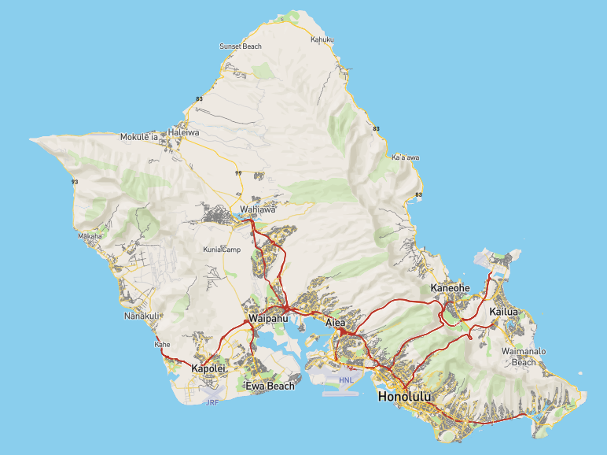
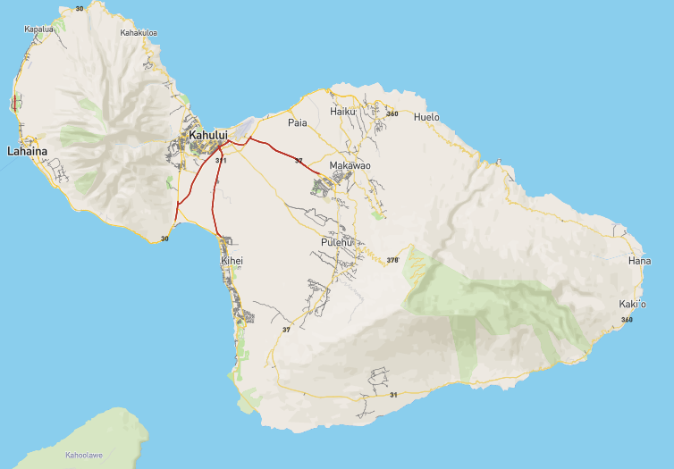
Proposed Projects: Oahu and Maui
H-1 Eastbound Improvements
Farrington Highway
Harbor Access Road
H-I, Kapolei Interchange Complex
Kunia Interchange Improvements
Salt Lake Boulevard
Puunene Ave
Lahaina Bypass Phase 1C
Paia Relief Route
Notes:
Overlay stars where the projects are
Clarify that the tool only works for urbanized areas Puuene A

Slide 7
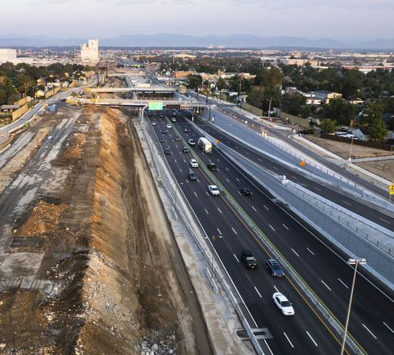
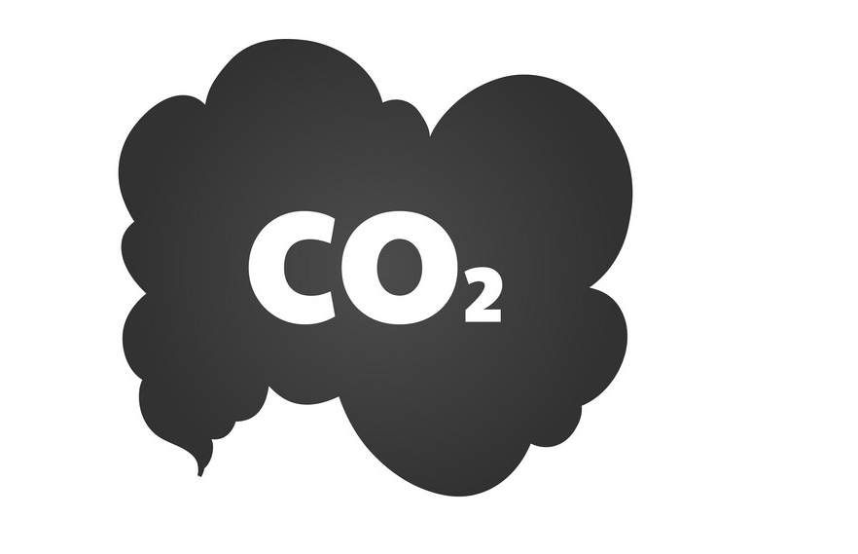
Total Impacts from Roadway Expansions
Impacts | Units
Lane-miles | 38 lane-miles
VMT | 144 Million
Gallons of Gasoline Eq. | 5.6 Million
Cars Eq. | 11,100 Cars
Emissions Eq. | 1.65 MMT CO2e
= 1.65 MMT CO2e
*Source : Hawaii Greenhouse Gas Emissions Report for 2016

